Slide 1
Walgreens

Slide 2
Redefining Consumer experience thru Omni channel transformation, High ROI on Investments & Future proof IT with Next-gen Engineering
Omni channel partner since 2010 - Implemented E-commerce, Omni-channel, Mobile, Loyalty, Digital Marketing & Analytics solutions
Human-centered design to deliver seamless experience across Web-site, Mobile and smart-watch channels
Agile/DevOps led engineering transformation - architecture standardization, tool rationalization, engineering principles
Powering the Integration center of excellence (ICC) with API, Micro services, Middleware based architecture
Enabled newer business models – Rx Refill, BOPIS, QuickPrints, STEPS etc.
Hardened existing legacy Apps and migrated silo-ed legacy stores apps to Java-stack
$4B
E-commerce revenue in 2019, up from $300M in 2010
>29M
No. of visits via digital channels per week
>60%
Online prescriptions through refill by scan
2-weeks
High-velocity release cycles
50%
Reduction in delivery time

Slide 3
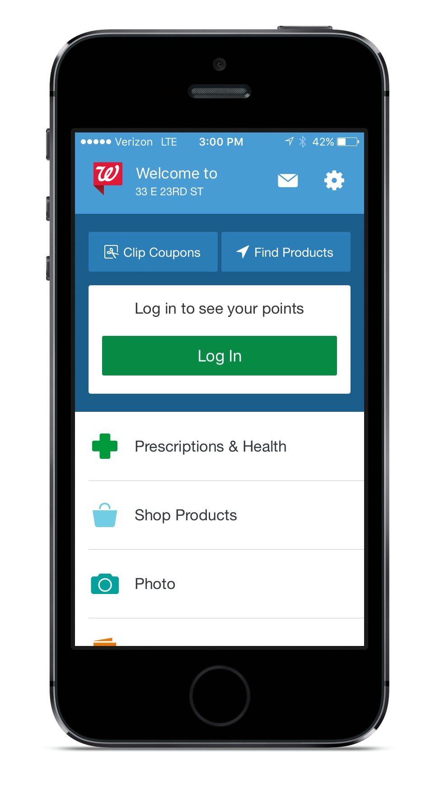
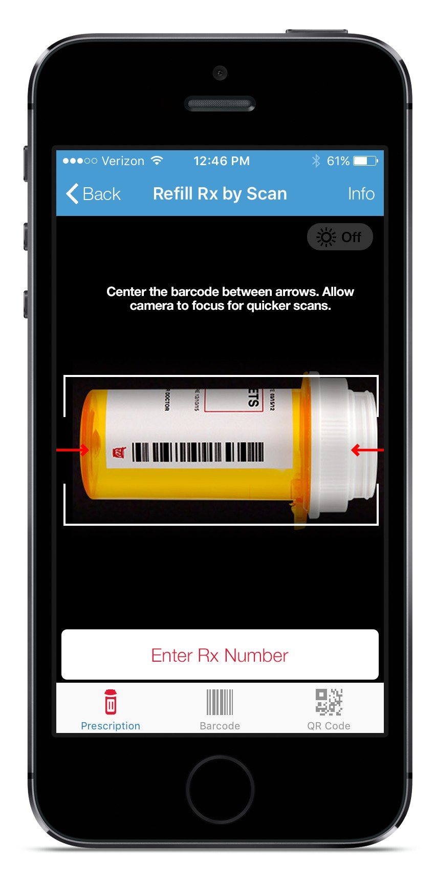
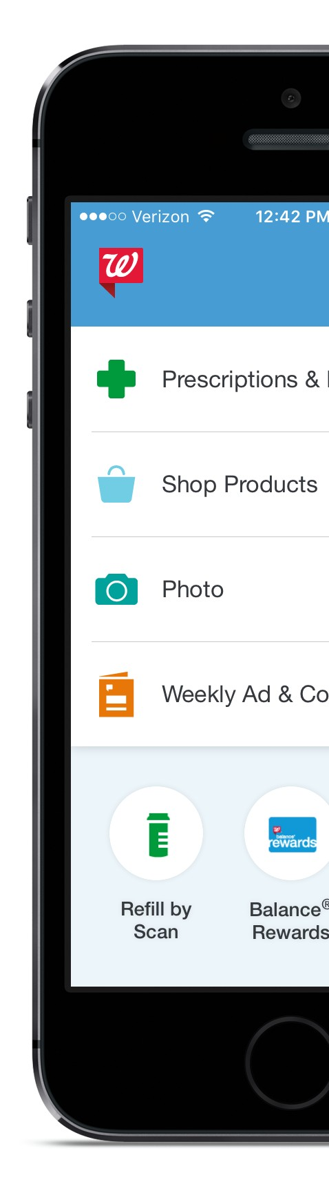
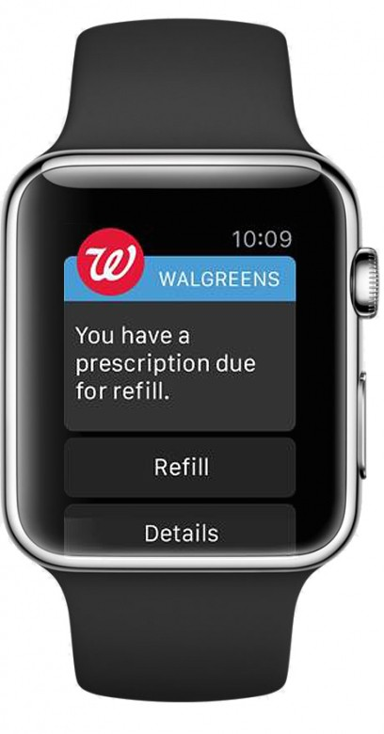
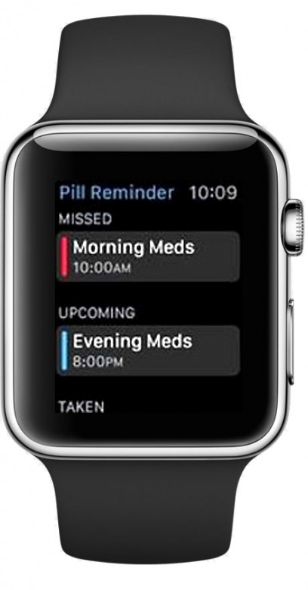
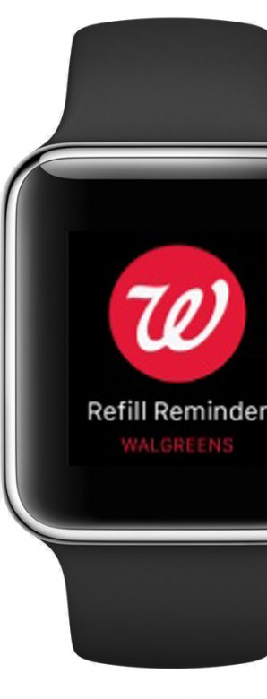
Cognizant extended clients Omni-channel experience to the Apple Watch via the first app designed to help users adhere to their medication regimen. Provided STEPS feature as part of Digital Wellness Journey.
Omni-Channel Impact and Growth via innovative products
Client’s award-winning mobile app turned users phone into a mobile drugstore helping to bridge the gap between the physical stores and digital.
Geo-fencing technology enables the app to recognize when a user is near a store and leverages this opportunity to push notifications for in-store offers and coupons.
Enabled Quick Prints Mobile Public API via APIGEE to help 3rd party developers develop Innovative Mobile apps to invoke Prints at Pharmacy stores and interface with backend AS/400 functionalities at the store.

Slide 4
Omni-Channel Impact and Growth Return on Investments
Prescription Refill
13% of in-store prescriptions driven by online transactions
40% of online prescriptions from mobile
Web Pickup
Doubled the average in- store transaction basket size to ~$25
Allowed customer to view store specific assortment and inventory
2-Day Delivery
Reduced the fulfillment cost/order by 15%
Reduced order delivery time by up to 50%
Delivered 66% of all online orders in 2 days.
Kiosk Ordering
Improved in-store order revenue by 100% YOY
Improved participation rate in stores by over 25%
Rewards & Loyalty
o Added 110 million members to the Balance Rewards program.
Mobile Wallet
Estimated $63MM cost savings & incremental revenue over 5 years
2.58% higher average basket size than regular users
Omni-Channel Payment
Increased in-store order conversion by 5% (~$500k)
Launched no-receipt returns in all 8,800+ stores
Enabled visibility to true LTV of each customer

Slide 5
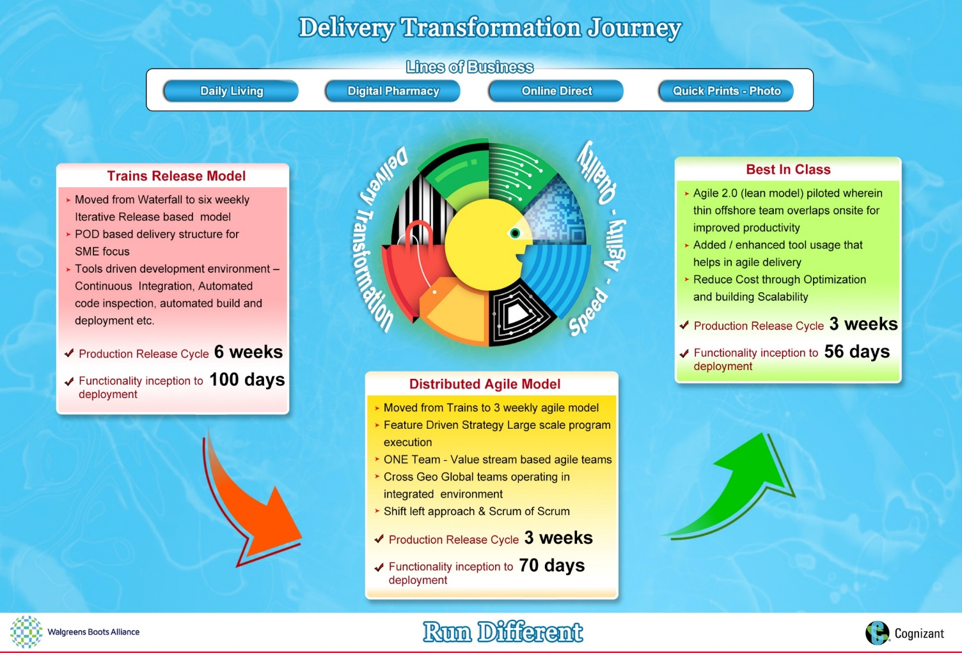
How we transformed the IT delivery

Slide 6
Waitrose

Slide 7

















Agile / DevOps Transformation for JLP Waitrose ecommerce(1/2)
Waterfall Model
Hybrid Agile / DevOps
Agile/DevOps/Cloud
Implementation Journey
IBM WCS Implementation with DB2
WCS Upgrade with AWS Migration
Migration to AWS Cloud, Micro services based Architecture
Delivery Model
Waterfall Delivery
Full Fledged Scrum Based Agile & BDD Automation
BDD based CD with DevOps;
Release Cycles
2 to 3 months release cycles
2 weeks - 1 month release cycles
Daily & Weekly releases
BUSINESS / IT JOURNEY
2014
2015
2016
2017
QA JOURNEY
Selenium CRAFT based regression automation
Mobile Automation using mintpro
Automated DSR thru Google Site
Regression Optimization
OF application Automation
Google Online Metrics Portal
Shared service model-Mobile & WCS teams
Hand held device testing-DPT
BDD Automation
Continuous deployment thru Jenkins Server
Cross skilled team
QA to QE transformation
Continuous delivery on the cloud
In sprint automation of multiple segments like API,UI,Performance & Integration
Parallel execution using selenium grid
Cross browser Automation-Browser stack
BDD integration with galen framework
112 hrs
50+ Releases in 6 months
HOMER FRAMEWORK
Migration
100%
3 hrs-15 min
90%
BUSINESS BENEFITS
Reduction in release defect fix turnaround time
Increase in release volumes-Faster time to market
Automation of functional acceptance criteria
Reduction in overnight release duration for production validations
Reduction in test execution effort from previous delivery model
KEY TOOLS & FRAMEWORKS
Communication – hangout/Facetime/Webcam
Daily Stand ups/Tasks – Trello/Slack
Cloud based version control

Slide 8




Agile / DevOps Transformation for JLP Waitrose ecommerce(2/2)
Continuous Delivery in DevOps
Adoption of Agile Manifesto
Behavior Driven Development
Automated Continuous testing using BDD
Benefits:
Benefits:
Continuous delivery process with Cloud bees Jenkins and AWS Cloud to enable seamless daily releases to LIVE-Faster time to market
Co-location of teams and encouraging face-to-face communication
Metrics-based measurement of progress (using tools like JIRA, TestRail, Jenkins and Kibana) based on business value
Benefits:
Significant reduction in turn around time for release of defect fixes
90 % savings in test Execution time compared to earlier delivery model.
One click deployment to LIVE through Jenkins pipeline
Reduction of overall test execution time to less than 10 minutes in LIVE thru 100% automation
Enables feature level / Epic / Story level automation
Automation coverage % increased to 100 % post BDD implementation
Early defect detection due to testing in Dev. environment
AWS Migration
QA to QE Transformation
Cross Browser Automation
Benefits:
Benefits:
Enables multi browser parallel execution using Browser Stack
Parallel browser execution
Daily based release to address CR faster
Over 50+ AWS releases in last 6 months
DevOps Impact led to Overnight release duration cut short to few minutes from 3-4 hours
Promotion of In-Sprint testing as exit criteria to LIVE (through complete test coverage within sprint)
100% Completion of multiple tests includes system, integration & regression with in the sprint
Defect prevention over defect detection for high quality and cycle time reduction
Increase in release volumes to 300%
Build test deployment process is automated without any manual intervention
JIRA-Test rail integration for reporting
Auto scaler selenium grid-Reduce the automation execution time in Jenkins pipeline
Benefits:
90% savings in Execution time compared to manual.
30-40 % increase in browser - OS coverage.
Zero Maintenance cost of Hardware infrastructure.

Slide 9
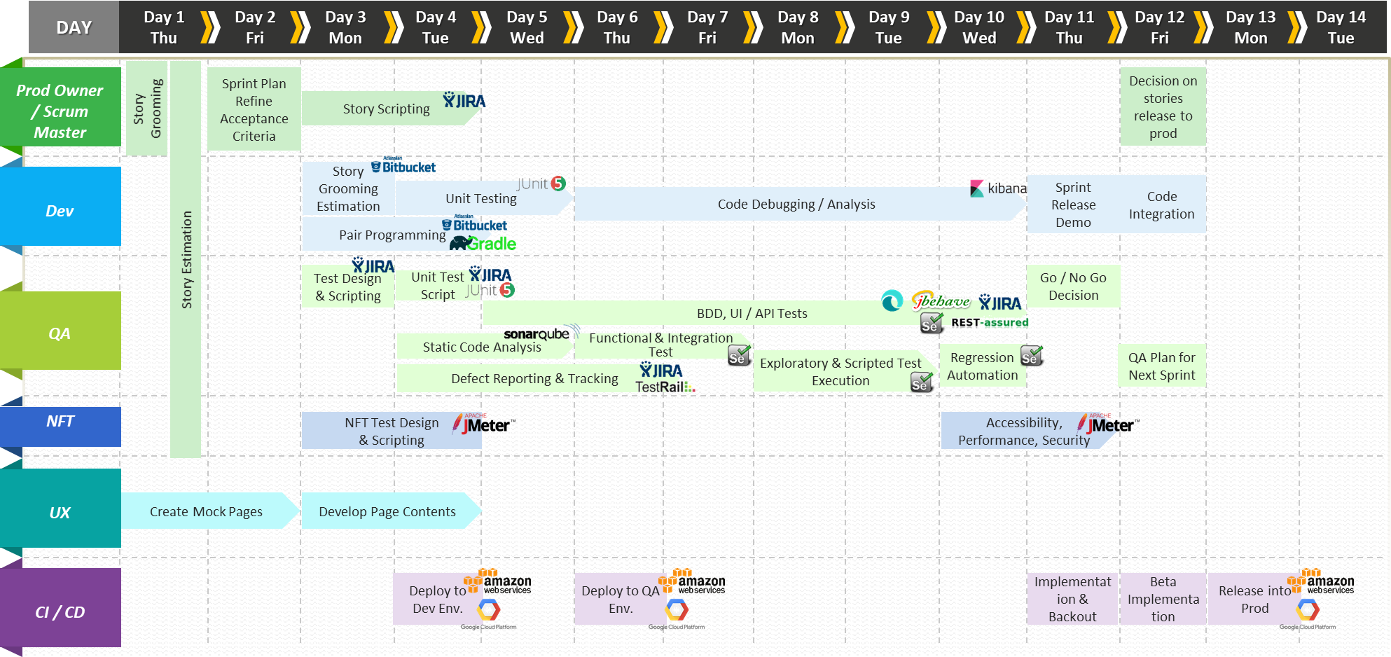
Typical 2 Week sprint for in-sprint team

